Slide 1


Machine Learning to diagnose Esophageal Cancer
Project 4 group:
Robert Franklin
Brianna O’Connor
Marisa Duong
21 March 2023
Notes:
ROB
Hi everyone, for our project Anshu, Zalak and I created an interactive data dashboard to explore the impact of interest rate changes on the Australian Housing market.

Slide 2
Table of contents
01 | Introduction | 3
02 | Data workflow | 5
03 | Our ML models | 7
04 | Front end: Streamlit | 12
05 | Limitations & Future Work | 14
Notes:
ROB
First, I will introduce project in more detail,
then we will look at our data analysis approach,
Then we’ll go through our interactive dashboard
And lastly at look at some of the limitations of our analysis with a view to future work,

Slide 3

Introduction
01
Notes:
ROB

Slide 4

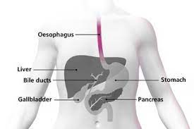
Introduction: Oesophageal cancer
Goal: Build Machine Learning models
Input: clinical data (age, sex, bmi)
and wet lab data (protein levels)
Output: predict Oesophageal cancer
Notes:
ROB
Inspiration for this project came from the need to understand the likely impacts of recent accelerated interest rate changes on the Australian housing market.
Just to give you a brief explanation of the terms we will use.
The Cash Rate, which is set by the Reserve Bank of Australia (RBA), affects the cost of borrowing money. When the Cash Rate is high, it's more expensive to borrow and may slow down the housing market. If it's low, borrowing is cheaper and the housing market may become more active. Over the last 10 years, the Cash Rate has decreased, but recently started to increase to address rising inflation.
The RBA's decisions on the cash rate can have a significant impact on the Australian housing market, and it’s really important for people to be aware of these changes.
This project is a unique contribution to understand these changes.

Slide 5
Data workflow
02
Notes:
ROB

Slide 6
Approach
01
Data source and visualisations
02
ETL
03
Build ML models
04
Front-end product
03
Published peer-reviewed journal article (supplementary data)
Tableau
Extraction: csv
Transform: Python (Jupyter Notebooks), Pandas DataFrame
Load: -
Logistic regression
and supervised machine learning models
Streamlit
Notes:
ROB 01- Data Sources
Only accessed official economic & govt data souces, specially the ABS and RBA
Looked at recent data only from about the last 10 years
I’ll now hand over to Anshu to talk through the ETL and Web Framework
ANSHU 02 & 03 – ETL & Web Framework
uses SQLAlchemy as the Object Relational Mapper (ORM) to interact with a remote database hosted on Amazon Web Services (AWS). The database username and password are stored in a gitignore file (console.py) to protect sensitive information.
Flask app serves as the dynamic content to the user's browser.
Use of ajax technique AJAX to send requests to the server in the background, without reloading the entire page, and updating parts of the page based on the response.
ROB 04 – Data Visualisation
Plotly for charts.
Leaflet for our maps, using D3 to get GeoJSON data for Australian states.

Slide 7

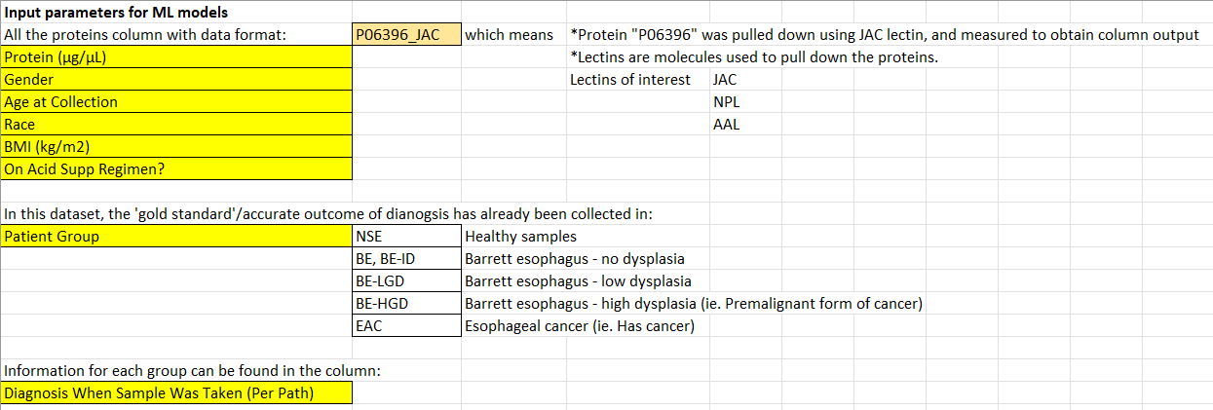
Data source
Notes:
ROB
First, we have some interactive data tables which were created using the DataTables plug-in for the jQuery JavaScript library.
Provides easy to use and interactive tables, this is real-time data
Dynamic filtering and sorting of data
User-friendly interface with intuitive navigation, caption with the link to the data source.
quick summary of each columns data.

Slide 8
Our ML models
03
Notes:
ROB
Now for a look at the output - our interactive dashboard

Slide 9
Grouping data
Notes:
ROB
First, we have some interactive data tables which were created using the DataTables plug-in for the jQuery JavaScript library.
Provides easy to use and interactive tables, this is real-time data
Dynamic filtering and sorting of data
User-friendly interface with intuitive navigation, caption with the link to the data source.
quick summary of each columns data.

Slide 10
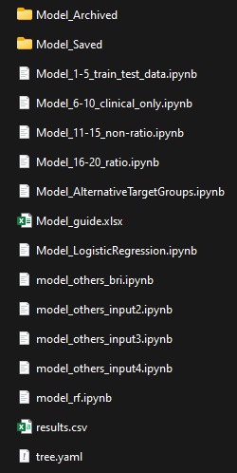
Supervised machine learning
ROC curves?
Notes:
ANSHU
Showcases relationship between interest rate changes and the Australian housing market through average house prices.
The graph shows the inverse relationship between the Cash Rate and average house prices. When the Cash Rate is high, it's more expensive to borrow and may slow down the housing market resulting in lower how prices. If it's low, borrowing is cheaper and the housing market may become more active.
Benefits of Plotly
Interactive and visually appealing representation of data
Allows for easy comparison of different states or Australia as a whole

Slide 11
Optimisation of ML models

Slide 12
Performance of ML models

Slide 13
Front end: Streamlit
04
Notes:
ROB
Now for a look at the output - our interactive dashboard

Slide 14
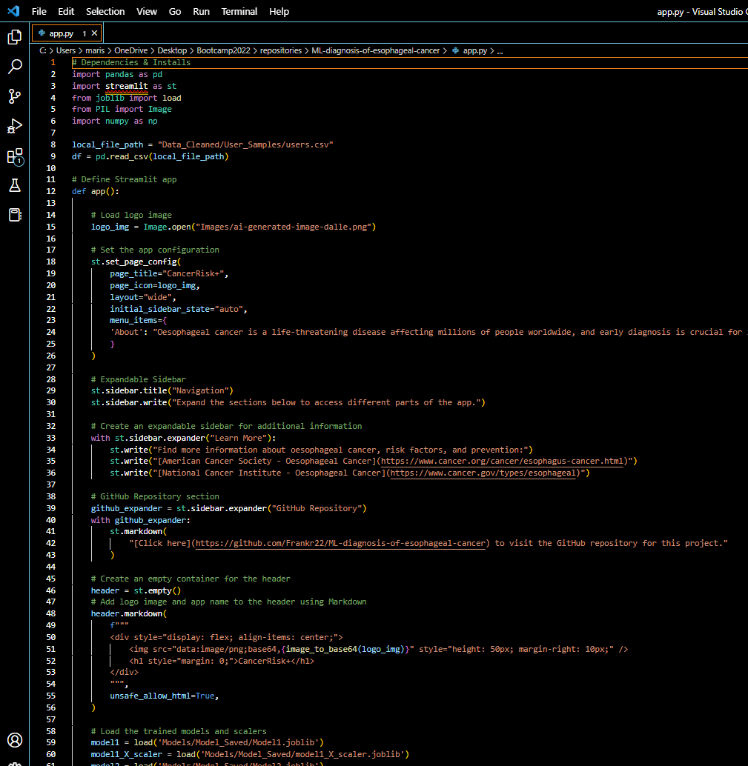
User friendly app interface to predict esophageal cancer

Slide 15
Limitations & Future Work
05
Notes:
ROB
Now for a look at the output - our interactive dashboard

Slide 16
Limitations & Future Work
Barrett’s esophagus: not included?
Optimise more models…
Improved Data Storage
GitHub repository: https://github.com/Frankr22/ML-diagnosis-of-esophageal-cancer
Notes:
There’s opportunities for future development and expansion of this project, such as incorporating additional data sources or expanding the scope of the analysis.
For example useful mortgage delinquency data, inflation data, and other key macroeconomic housing market indicators
Improved layout css and html
Time consuming,
More interactivity
Database setup
The current setup uses SQLAlchemy as the Object Relational Mapper (ORM) to interact with a remote database hosted on Amazon Web Services (AWS). The database username and password are stored in a gitignore file (console.py) to protect sensitive information.
A simpler and more straightforward solution, would be to switch the database to a local SQLite database that is stored as a file on the user’s local machine. The SQLite database does not require a remote connection or authentication, so there is no need to store the database credentials in a separate file.
With the current setup, the database is hosted remotely on AWS and requires a connection over the internet, which can be slower and more susceptible to network issues. With the SQLite option, the database is stored locally on the user's machine, which allows for faster access times and eliminates the need for a remote connection.

Slide 17
Q&A
Notes:
That’s the end of our presentation, so now we’ll open up to some questions.

